Slide 1
YOUTUBE DOWNLOADER USING PYTHON
Group NO: G2
Presented BY: SANKET GHODKE (21)
Rakesh Chaure (12)
Gopal GHuLE (22)
swapnil Jadhav (25)
Guided By: Dr. Praveen Shetiye

Slide 2
Why we Choose this ???
Fond of YT Videos .
Entertainment and Educational Purposes.
Ads content issue persist.
Ad-free downloader.
aim was to learn about python’s tkinter library.
Making Other GUI based Applications.

Slide 3
What is Tkinter library???
Standard GUI library for Python.
Python when combined with Tkinter provides a fast and easy way to create GUI applications.
Tkinter provides a powerful object-oriented interface to the Tk GUI toolkit.
Creating a GUI application using Tkinter is an easy task.
All you need to do is perform the following steps −
Import the Tkinter module.
Create the GUI application main window.
Add one or more of the above-mentioned widgets to the GUI application.
Enter the main event loop to take action against each event triggered by the user.

Slide 4
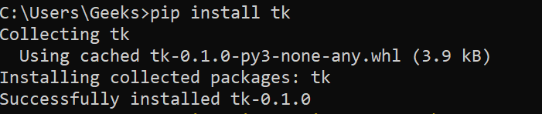
Installing Tkinter Library

Slide 5
What IS Pafy???
Pafy is a Python library to download YouTube content and retrieve metadata.
Parameters:
1. url (str) – The YouTube url or 11 character video id of the video
2. basic (bool) – fetch basic metadata and streams
3. gdata (bool) – fetch gdata info (upload date, description, category, username, likes, dislikes)
4. signature (bool) – Note: The signature argument now has no effect and will be removed in a future version
5. size (bool) – fetch the size of each stream (slow)(decrypts urls if needed)
6. callback (function) – a callback function to receive status strings

Slide 6
Pafy Attributes:
Once you have created a Pafy object using pafy.new(), several data attributes are available:
1. Pafy.author : The author of the video (str).
2. Pafy.bigthumb(*str*): The url of the video’s display image (not always available).
3. Pafy.bigthumbhd: The url of the video’s larger display image (not always available) (str).
4. Pafy.category: The category of the video (str).
5. Pafy.description: The video description text (str).
6. Pafy.dislikes: The number of dislikes received for the video (int).
7. Pafy.duration: The duration of the stream (string formatted as HH:MM:SS).
8. Pafy.keywords: A list of the video’s keywords (not always available) ([str]).
9. Pafy.length: The duration of the streams in seconds (int).
10. Pafy.likes: The number of likes received for the video (int).

Slide 7
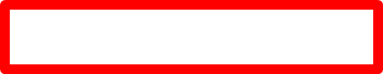
PyINSTALLER:
PyInstaller is a normal Python package. You can download the archive from PyPi, but it is easier to install using pip, for example:
pip install pyinstaller
or upgrade to a newer version:
pip install --upgrade pyinstaller
To install the current development version use:
pip install https://github.com/pyinstaller/pyinstaller/tarball/develop

Slide 8
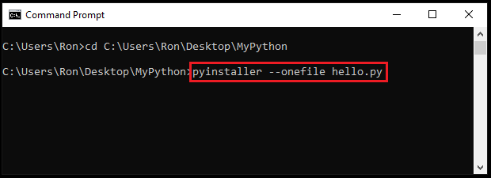

Slide 9
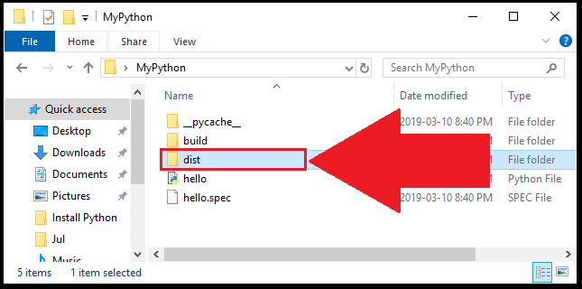

Slide 10
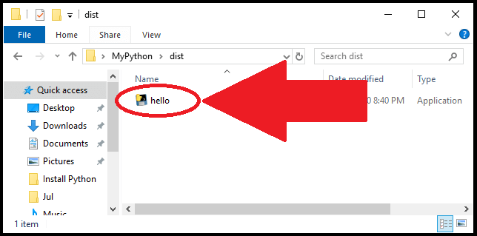

Slide 11
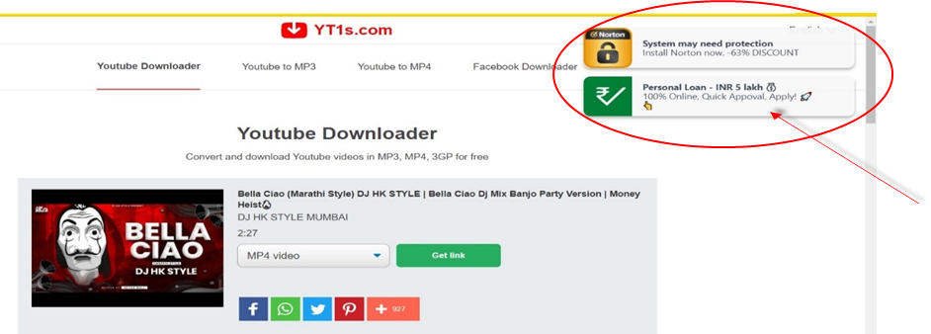
Differences between Other YT Downloaders
Fig: YT1 Downloader contains pop-ups.

Slide 12
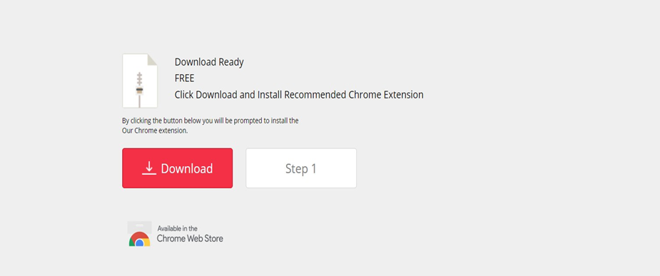
Fig: YT1s Showing the Download third party application pop-up

Slide 13
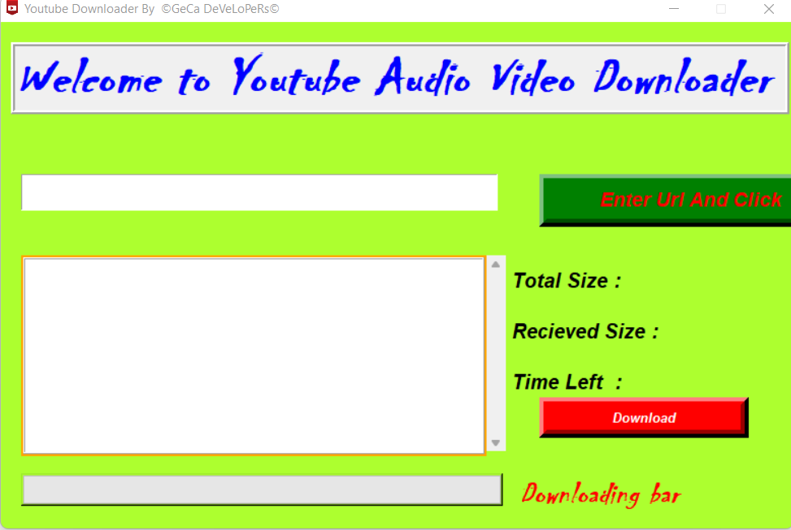
Let’s began the coding :
from tkinter import *
from tkinter.ttk import Progressbar
from tkinter import PhotoImage
from tkinter import filedialog
import random
import threading # to keep running downloadvideo()
import pafy #downloading youtube video details
root = Tk()
root.title('Youtube Downloader By ' " ©GeCa DeVeLoPeRs©")
root.configure(bg='#ADFF2F')
root.geometry('780x500')
root.resizable(False, False)
root.attributes()
photo=PhotoImage(file=("C:\\Users\\sghod\PycharmProjects\\YoutubeDownloader\\Youtube1.png"))
root.iconphoto(False,photo)

Slide 14
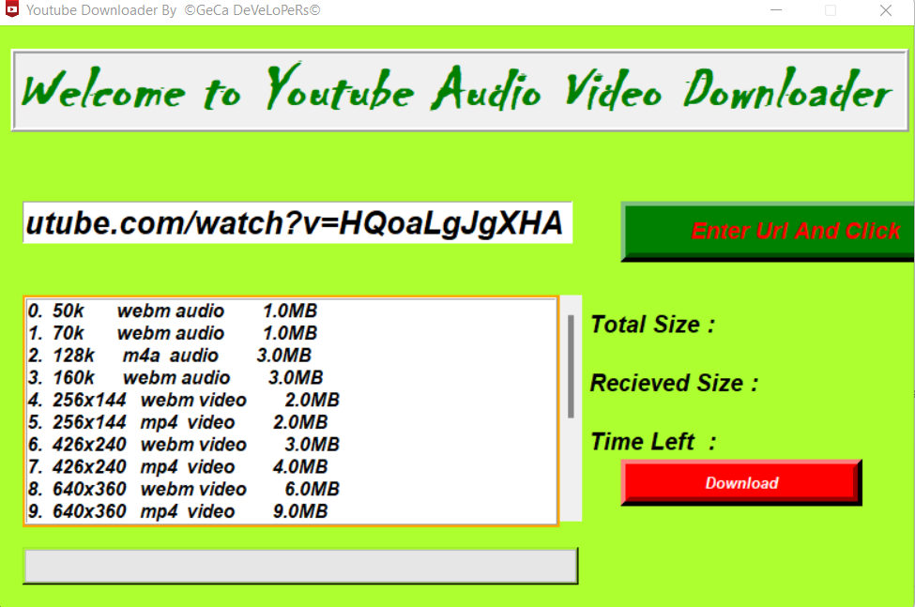
# scrollbar
scrollbar = Scrollbar(root)
scrollbar.place(x=477, y=230, height=193, width=20)
# Youtube Url text
urltext = StringVar()
UrlEntry = Entry(root, textvariable=urltext, font=('arial', 20, 'italic bold'), width=31)
UrlEntry.place(x=20, y=150)
# Labels
IntroLabel = Label(root, text='Welcome to Youtube Audio Video Downloader ', width=36, relief='ridge', bd=4,
font=('chiller', 40, 'italic bold'), fg='red')
IntroLabel.place(x=10, y=20)
ChangeIntroLabelColor()
ListBox = Listbox(root, yscrollcommand=scrollbar.set, width=50, height=10, font=('arial', 12, 'italic bold'),
relief='ridge', bd=2, highlightcolor="blue", highlightbackground="orange", highlightthickness=2)
ListBox.place(x=20, y=230)
ListBox.bind("<<ListboxSelect>>", SelectCursor)
scrollbar.configure(command=ListBox.yview)

Slide 15
# Downloading Size label
DownloadnigSizeLabel = Label(root, text='Total Size : ', font=('arial', 15, 'italic bold'), bg='#ADFF2F')
DownloadnigSizeLabel.place(x=500, y=240)
DownloadnigLabel = Label(root, text='Recieved Size : ', font=('arial', 15, 'italic bold'), bg='#ADFF2F')
DownloadnigLabel.place(x=500, y=290)
DownloadnigTime = Label(root, text='Time Left : ', font=('arial', 15, 'italic bold'), bg='#ADFF2F')
DownloadnigTime.place(x=500, y=340)
DownloadnigSizeLabelResult = Label(root, text='', font=('arial', 15, 'italic bold'), bg='#ADFF2F')
DownloadnigSizeLabelResult.place(x=650, y=240)
DownloadnigLabelResult = Label(root, text='', font=('arial', 15, 'italic bold'), bg='#ADFF2F')
DownloadnigLabelResult.place(x=650, y=290)
DownloadnigLabelTimeLeft = Label(root, text='', font=('arial', 15, 'italic bold'), bg='#ADFF2F')
DownloadnigLabelTimeLeft.place(x=650, y=340)
DownloadingBarTextLable = Label(root, text='Downloading bar', width=36, font=('chiller', 23, 'italic bold'), fg='red',
bg='#ADFF2F')
DownloadingBarTextLable.place(x=370, y=445)
DownloadingProgressBarLabel = Label(root, text='', width=36, font=('chiller', 40, 'italic bold'), fg='red', bg='#ADFF2F',
relief='raised')
DownloadingProgressBarLabel.place(x=20, y=445)

Slide 16
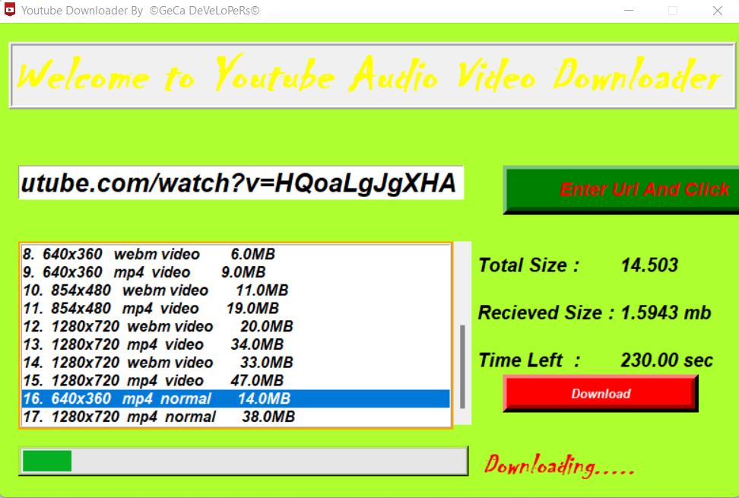
Adding Buttons and Progress bar:
# Progress Bar
DownloadnigProgressBar = Progressbar(DownloadingProgressBarLabel, orient=HORIZONTAL, value=0, length=100, maximum= total12)
DownloadnigProgressBar.grid(row=0, column=0, ipadx=185, ipady=3)
# Buttons
ClickButton = Button(root, text='Enter Url And Click', font=('Arial', 14, 'italic bold'), bg='green', fg='red',activebackground='blue', width=23, bd=8, command=VideoUrl)
ClickButton.place(x=530, y=150)
DownloadButton = Button(root, text='Download', font=('Arial', 10, 'italic bold'), bg='red', fg='white',activebackground='blue', width=23, bd=8,command=DownloadVideo)
DownloadButton.place(x=530, y=370)

Slide 17
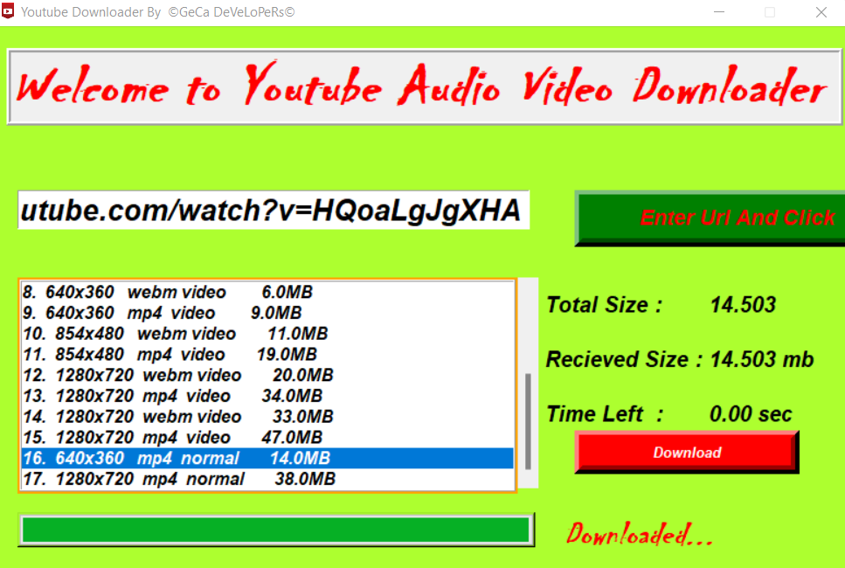
Adding Changeintrolabelcolor( ):
To change color of introlabel text after every 20 seconds.
colors = ['red', 'green', 'blue', 'yellow', 'gold', 'pink']
def ChangeIntroLabelColor():
ss = random.choice(colors)
IntroLabel.configure(fg=ss)
IntroLabel.after(20, ChangeIntroLabelColor)

Slide 18
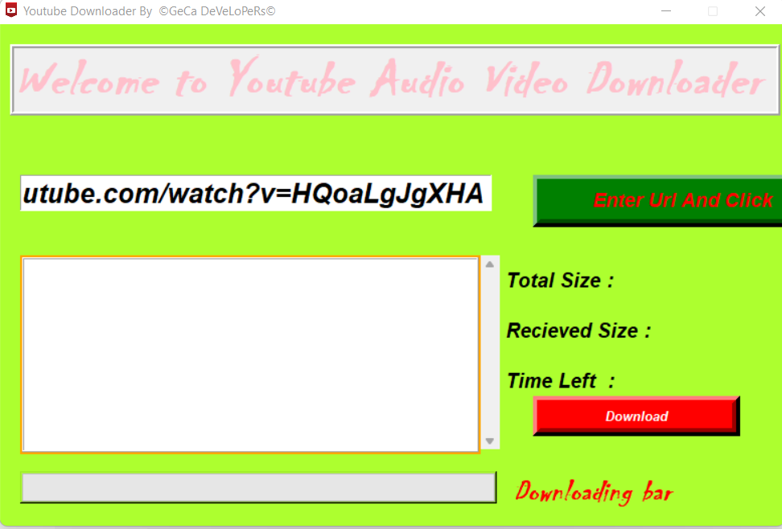
Getting Video Details using Pafy library from the fetched URL:
def VideoUrl():
DownloadingBarTextLable.configure(text="")
DownloadnigLabelResult.configure(text="")
DownloadnigSizeLabelResult.configure(text="")
DownloadnigLabelTimeLeft.configure(text="")
getdetail = threading.Thread(target=getvideo)
getdetail.start()
def getvideo():
global streams
ListBox.delete(0, END)
url = urltext.get()
data = pafy.new(url)
streams = data.allstreams #getting all types of streams to download
index = 0
for i in streams:
du = '{:0.1f}'.format(i.get_filesize()//(1024*1024))
datas = str(index) + '.'.ljust(3, ' ') + str(i.quality).ljust(10, ' ') + str(i.extension).ljust(5, ' ') + str(i.mediatype) + ' ' + du.rjust(10, ' ') + "MB"
ListBox.insert(END, datas)
index += 1
Resetting all values to null when new link is pasted
Inserting streams into Listbox
Converting kbs into mbs.

Slide 19

BindinG the Mouse Click Event with ListBox and adding Threads to keep the program running :
Establishing interaction between ListBox and selected cursor item
def SelectCursor(evt):
global downloadindex
listboxdata = ListBox.get(ListBox.curselection())
print(listboxdata)
downloadstream = listboxdata[:3]
downloadindex = int(''.join(x for x in downloadstream if x.isdigit()))
def DownloadVideo():
getdata = threading.Thread(target=DownloadVideoData)
getdata.start()
To switch from one thread of getting url to downloading data about video thread.

Slide 20
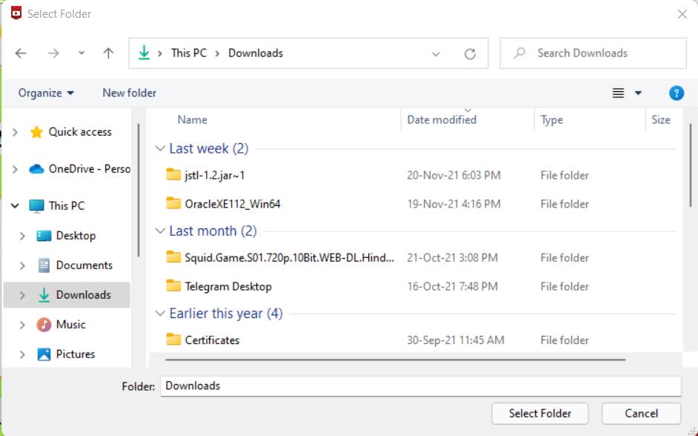

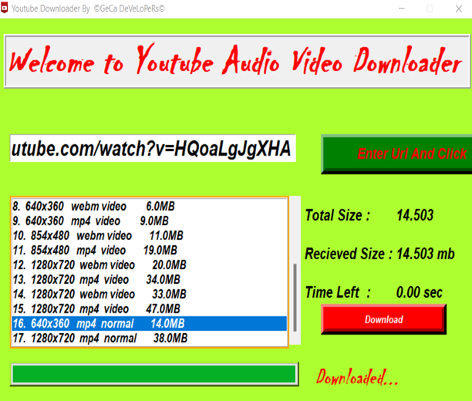
Downloading video data and changing downloading text labels :
def DownloadVideoData():
global downloadindex
fgr = filedialog.askdirectory()
DownloadingBarTextLable.configure(text="Downloading.....")
def mycallback(total, recvd, ratio, rate, eta):
global total12
total12 = float('{:.5}'.format(total/(1024*1024)))
DownloadnigProgressBar.configure(maximum=total12)
recieved1 = '{:.5} mb'.format(recvd / (1024 * 1024))
eta1 = '{:.2f} sec'.format(eta)
DownloadnigSizeLabelResult.configure(text=total12)
DownloadnigLabelResult.configure(text=recieved1)
DownloadnigLabelTimeLeft.configure(text=eta1)
DownloadnigProgressBar['value'] = recvd/(1024*1024)
streams[downloadindex].download(filepath=fgr, quiet=True, callback=mycallback)
DownloadingBarTextLable.configure(text="Downloaded...")

Slide 21
References :
https://docs.python.org/3/
https://www.w3schools.com/python/
https://www.youtube.com/watch?v=Q4lm8eYulw&list=PLu0W_9lII9ajLcqRcj4PoEihkukF_OTzA
https://www.youtube.com/watch?v=GhzpvvIXlM&list=PLS1QulWo1RIY6fmY_iTjEhCMsdtAjgbZM
https://docs.python.org/3/library/tkinter.html
https://pythonhosted.org/pafy/
https://pypi.org/project/youtube_dl/
https://pypi.org/project/pyinstaller/

Slide 22
THANK YOU

